Slide 1
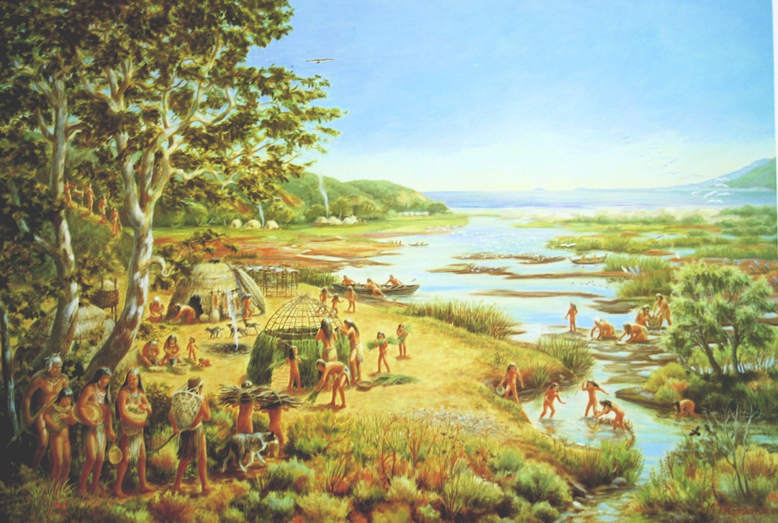

Slide 2
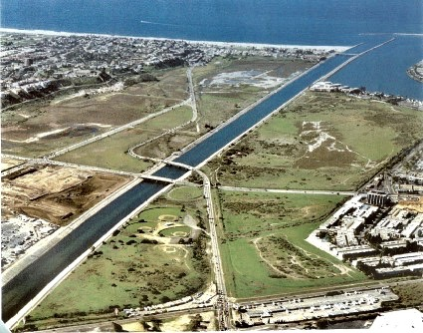

Slide 3
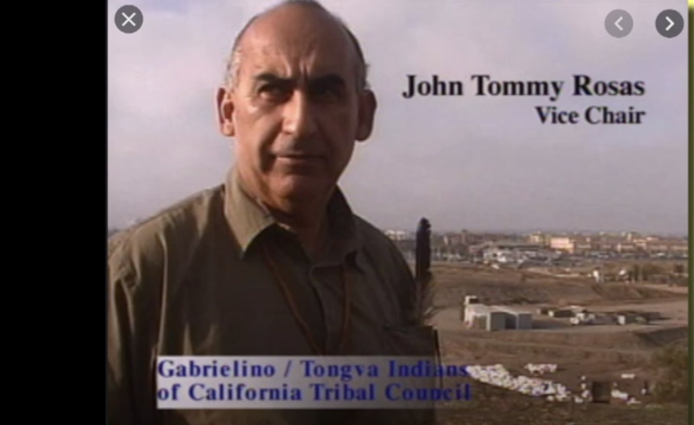
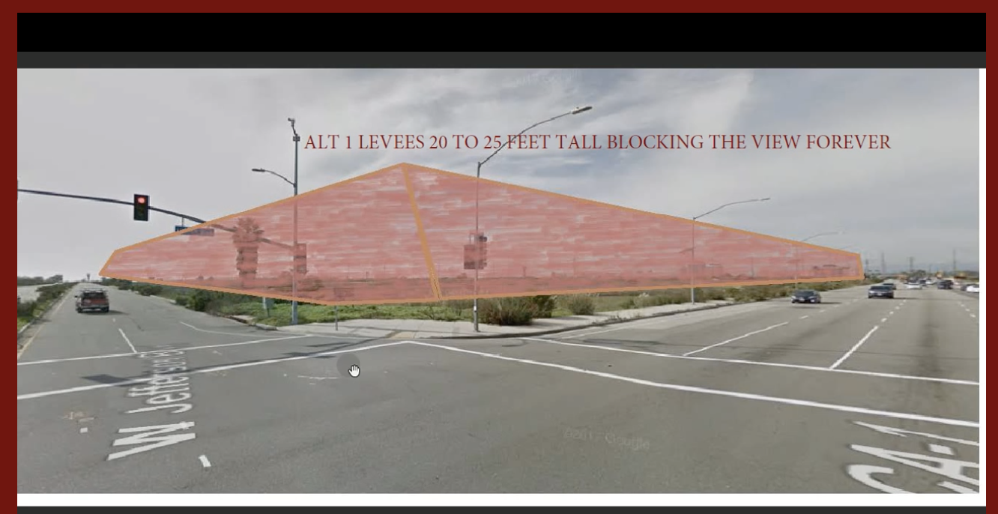
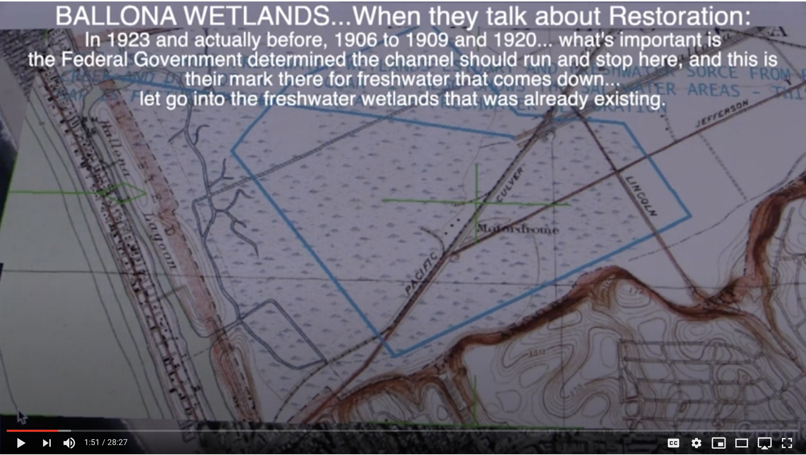
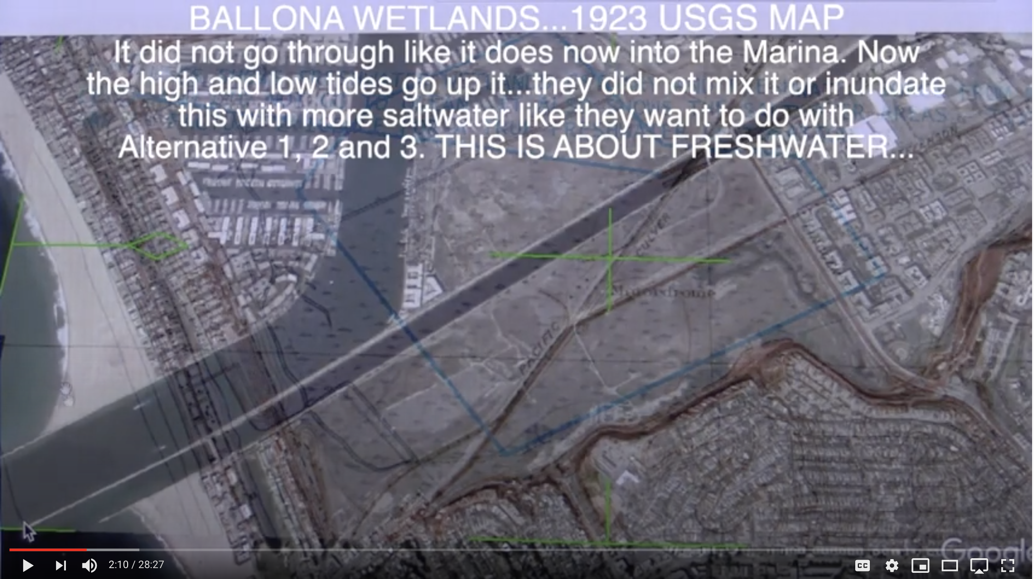
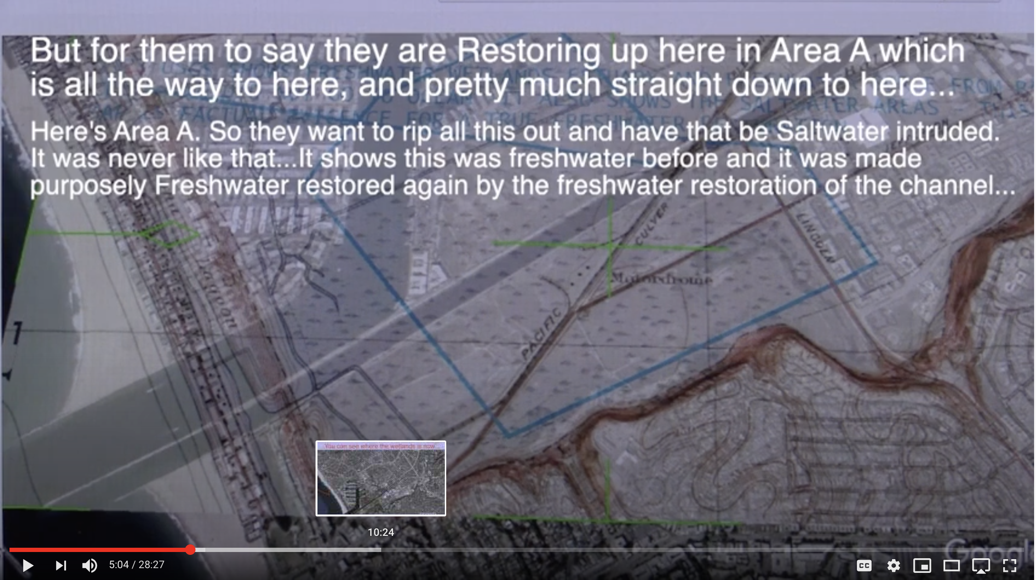
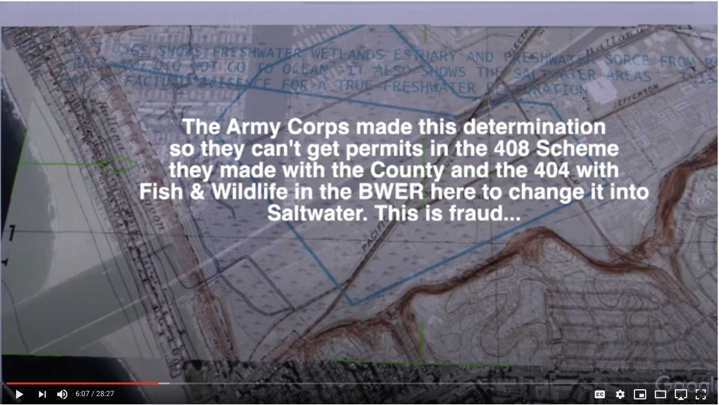
2018-19 PROOF BALLONA IS A PREDOMINANTY FRESHWATER SEASONAL WETLAND – by JohnTommy Rosas, Indigenous Tongva 28 Minutes 27 Seconds (first 10+ minutes most critical) https://youtu.be/x9-YY6UaoC0

Slide 4
STATEMENT BY ANTHONY MORALES
I, Anthony Morales support John Tommy Rosas’ (Tribal Litigator for Tongva Ancestral Tribal Territorial Nation) comments in this Ballona Wetlands Power Point Presentation and his 28 Minute YouTube https://youtu.be/x9-YY6UaoC0
I, Anthony Morales, have standing as Chief of the Gabrieleno - Tongva San Gabriel Band of Mission Indians. Furthermore, I am letting the Coastal Commissioners and staff know that both I and my son are recognized by the State and Federal Government as being authorized to represent the Native American issues of the Ballona Wetland region and provide monitoring of sensitive, native cultural sites, within Ballona. We will make ourselves available as monitors for the Ballona Wetlands which was certified as a Sacred Site by John Tommy Rosas, a most likely descendent.
Our offer includes the portion of Ballona where the unpermitted drains are located. And, should the Co-Commissioners order the preferred removal of the unpermitted spur lines and drains, or abandonment in place, we wish to avail ourselves for monitoring.
Thank you

Slide 5
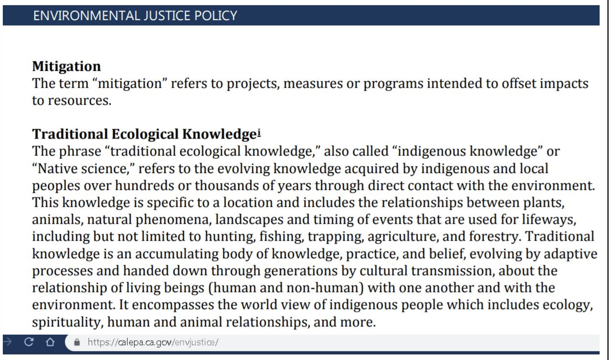

Slide 6
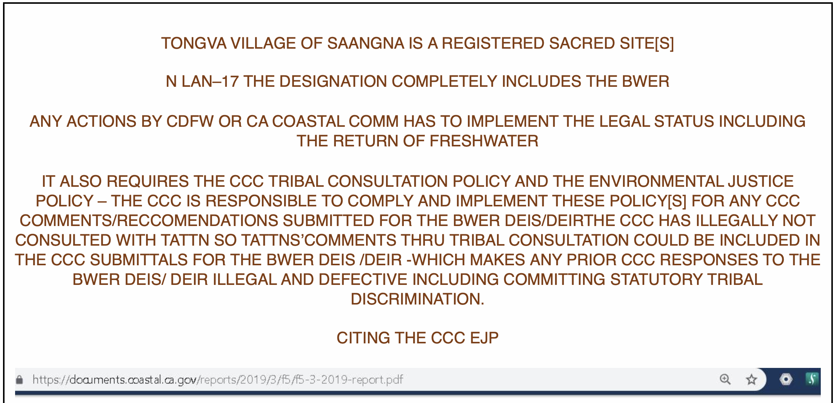

Slide 7
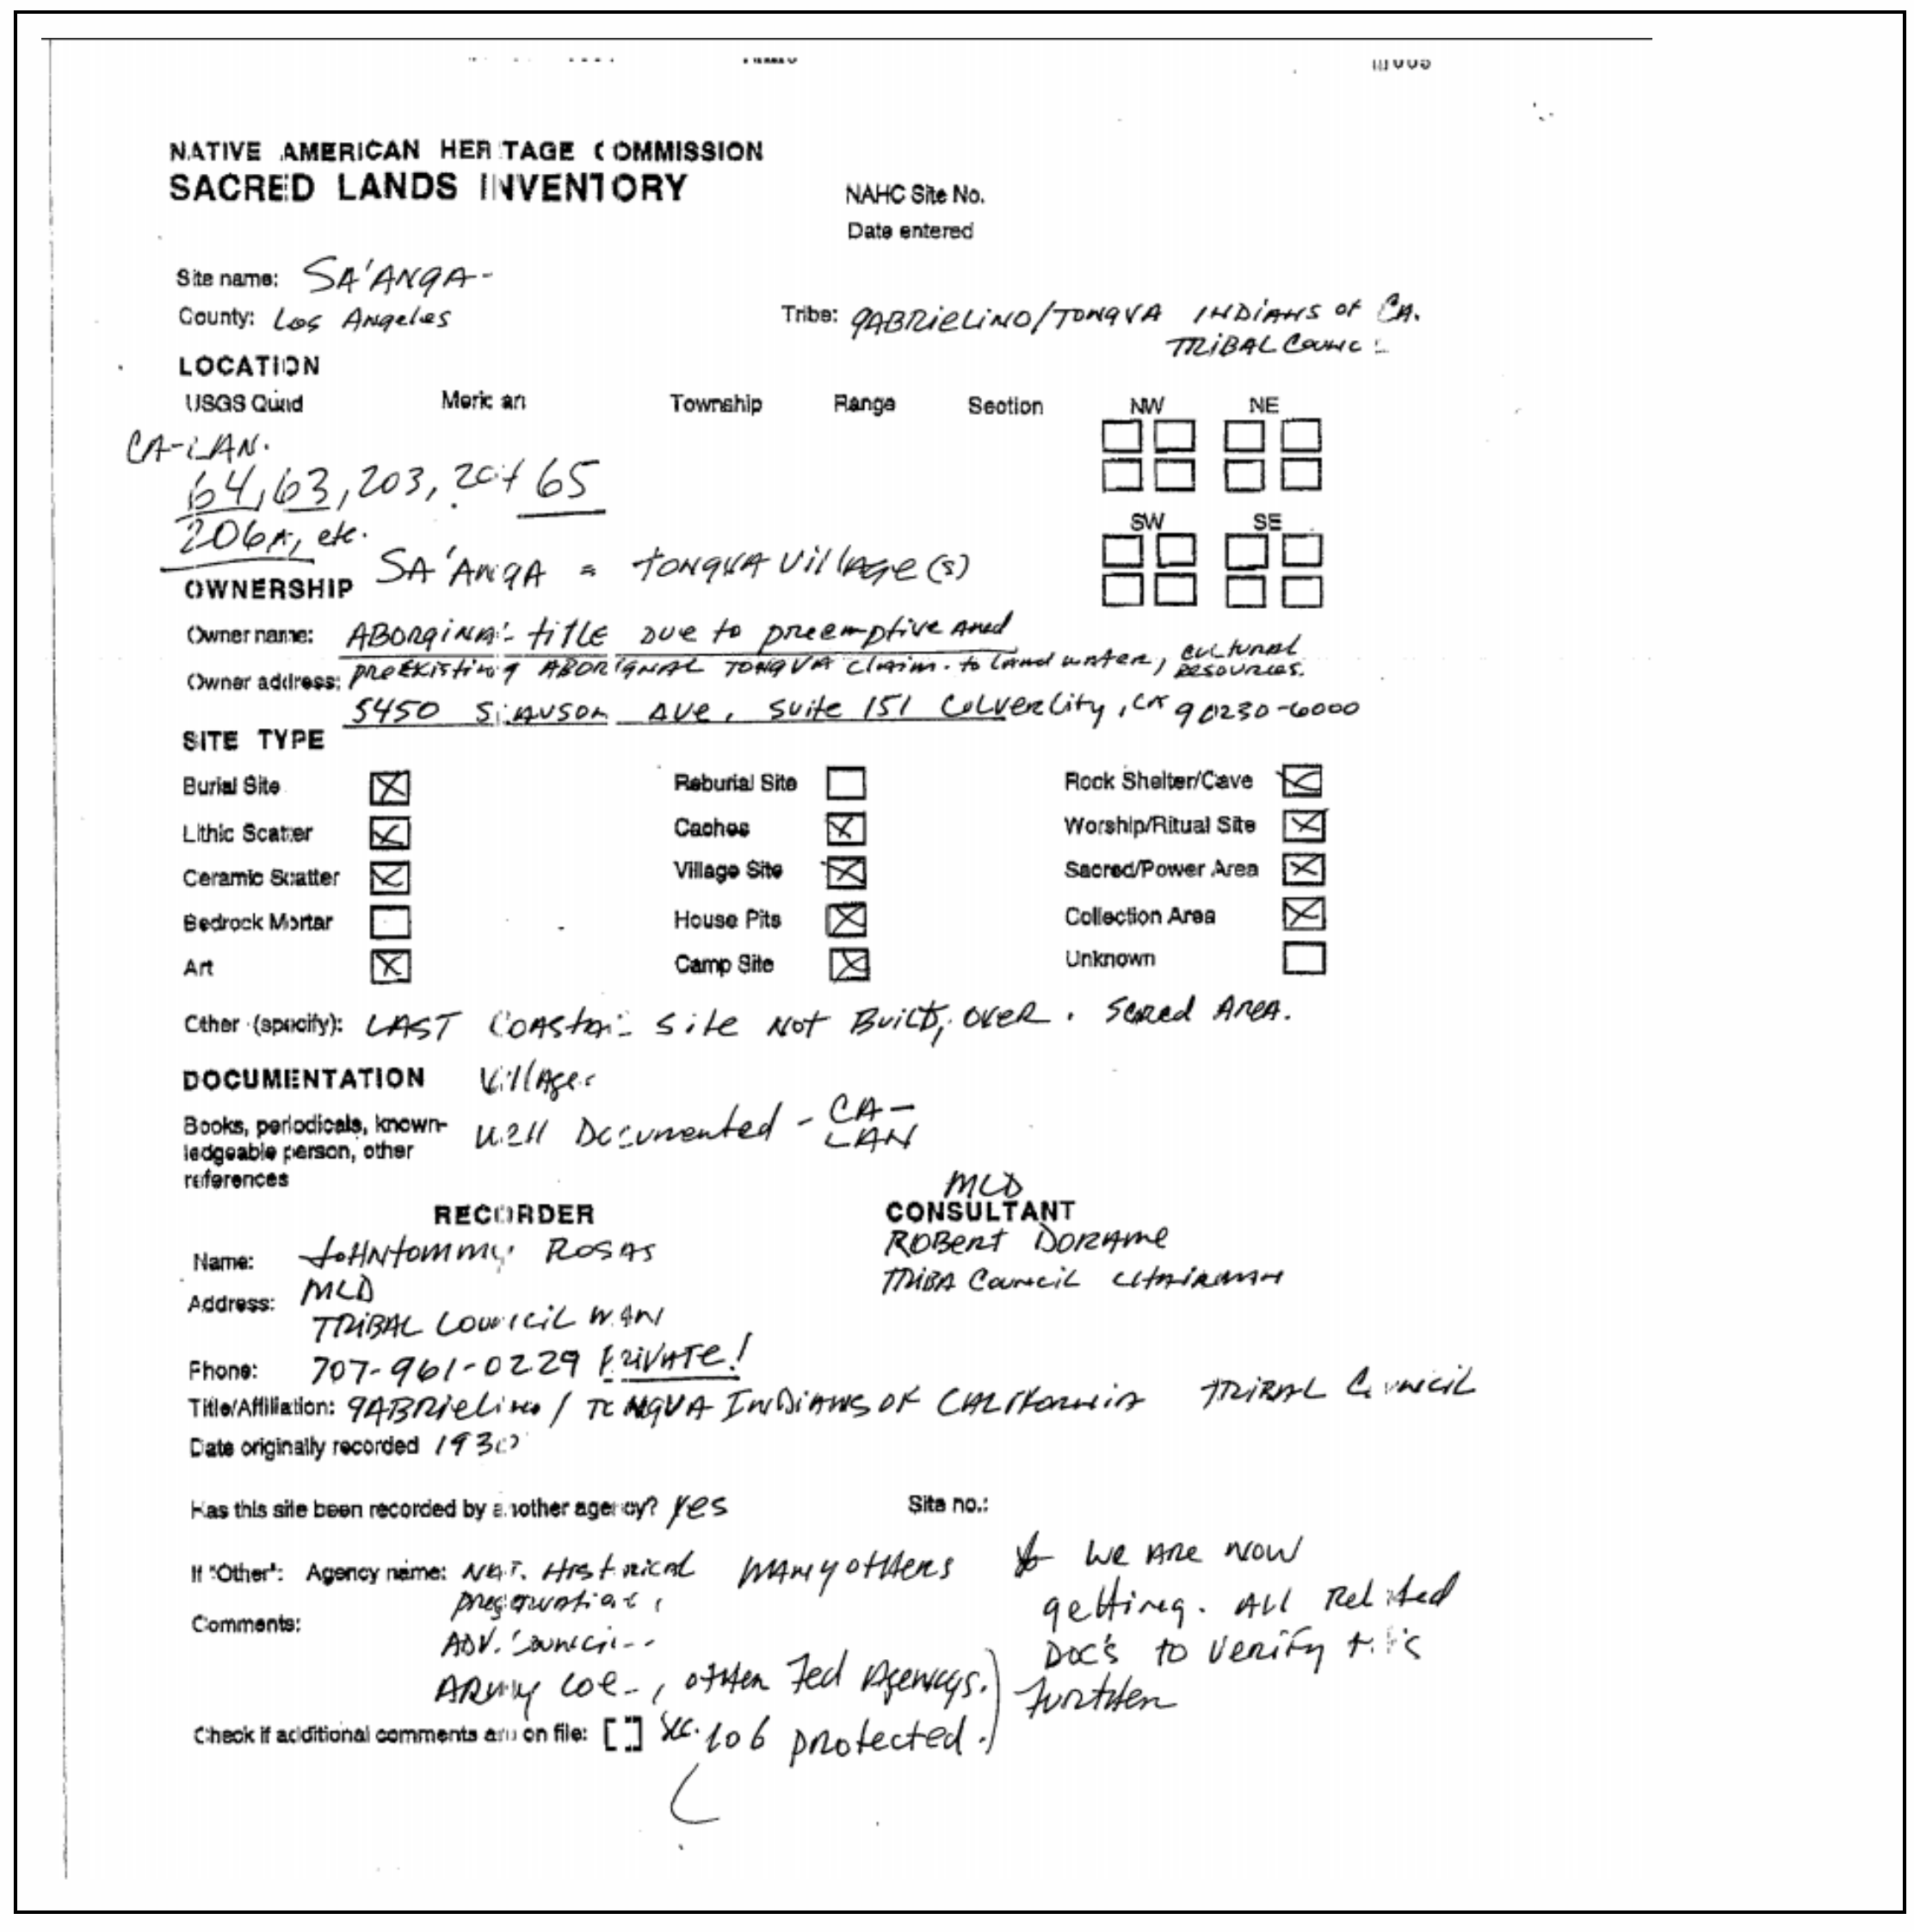

Slide 8
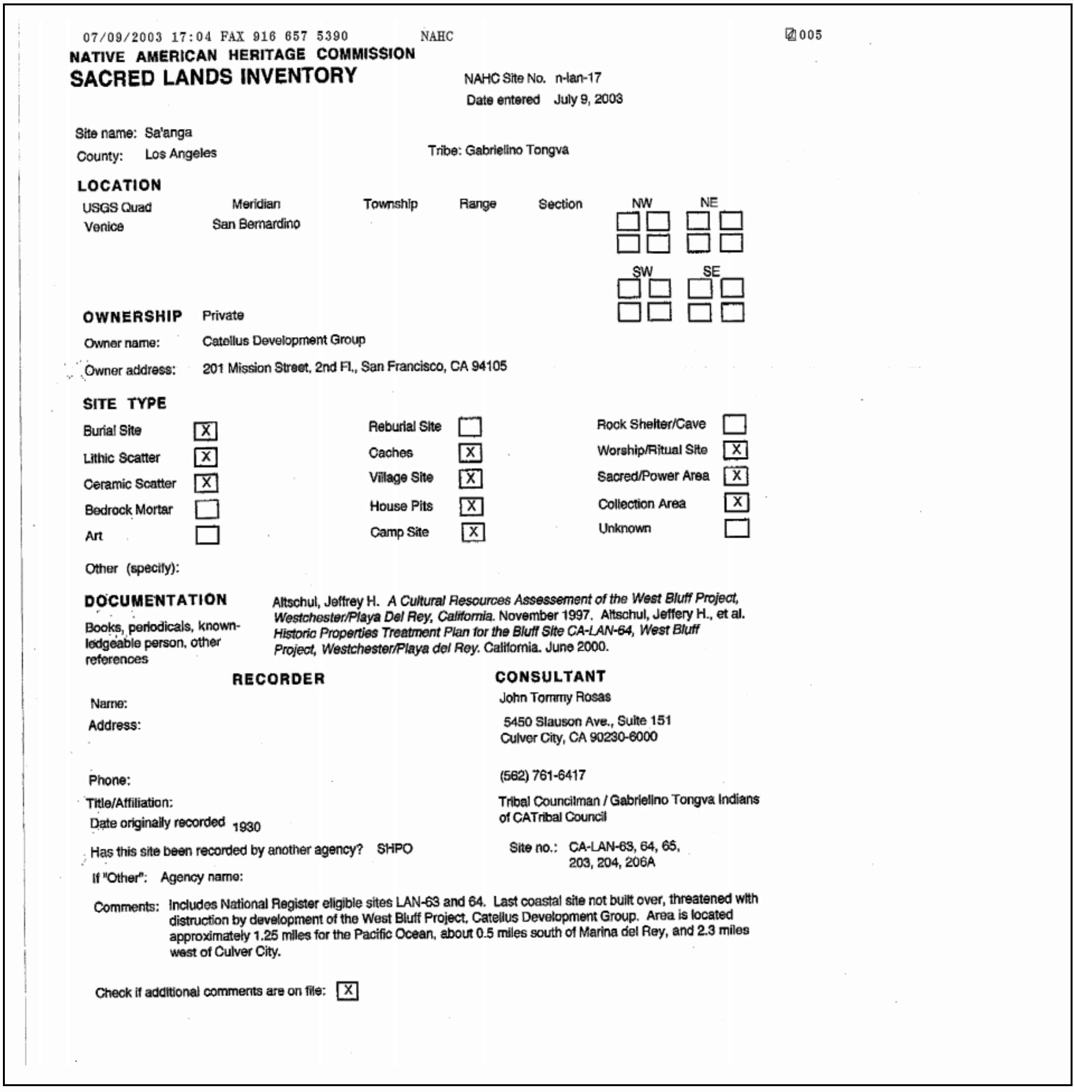

Slide 9
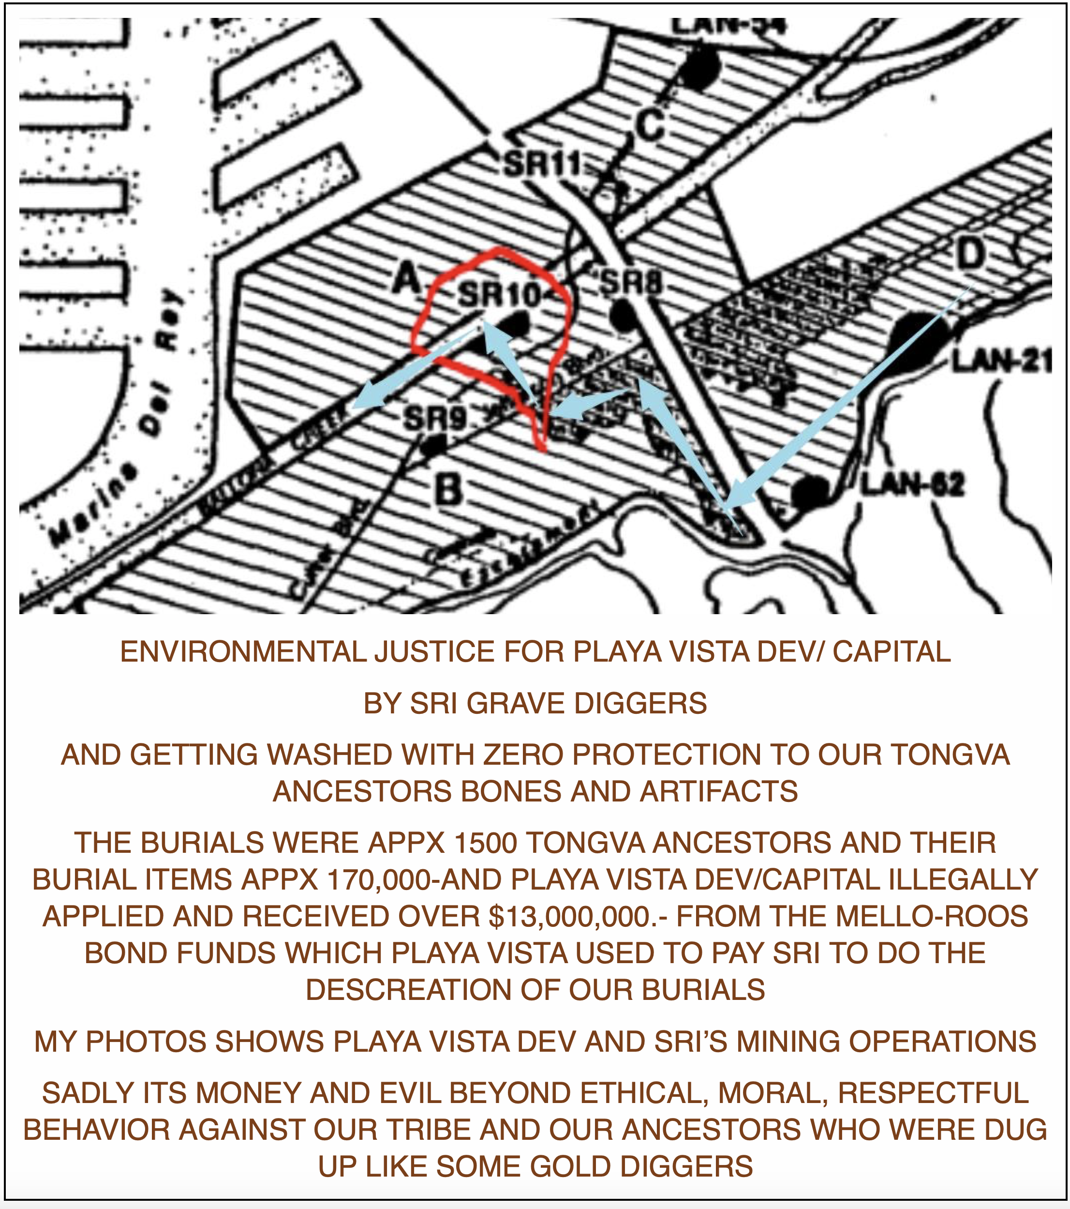

Slide 10
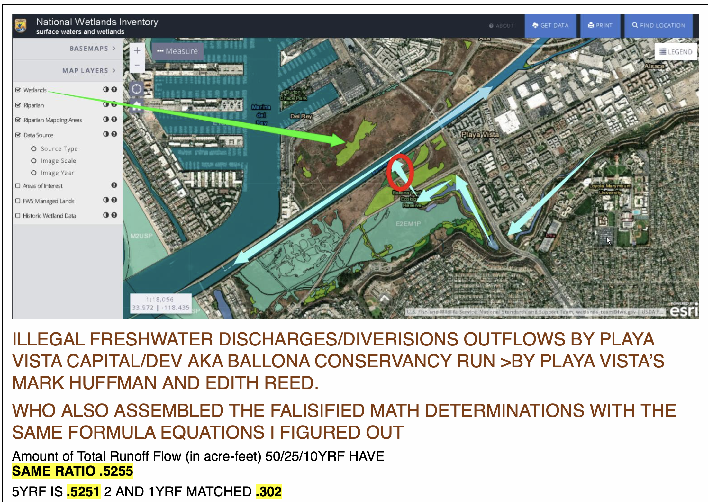

Slide 11
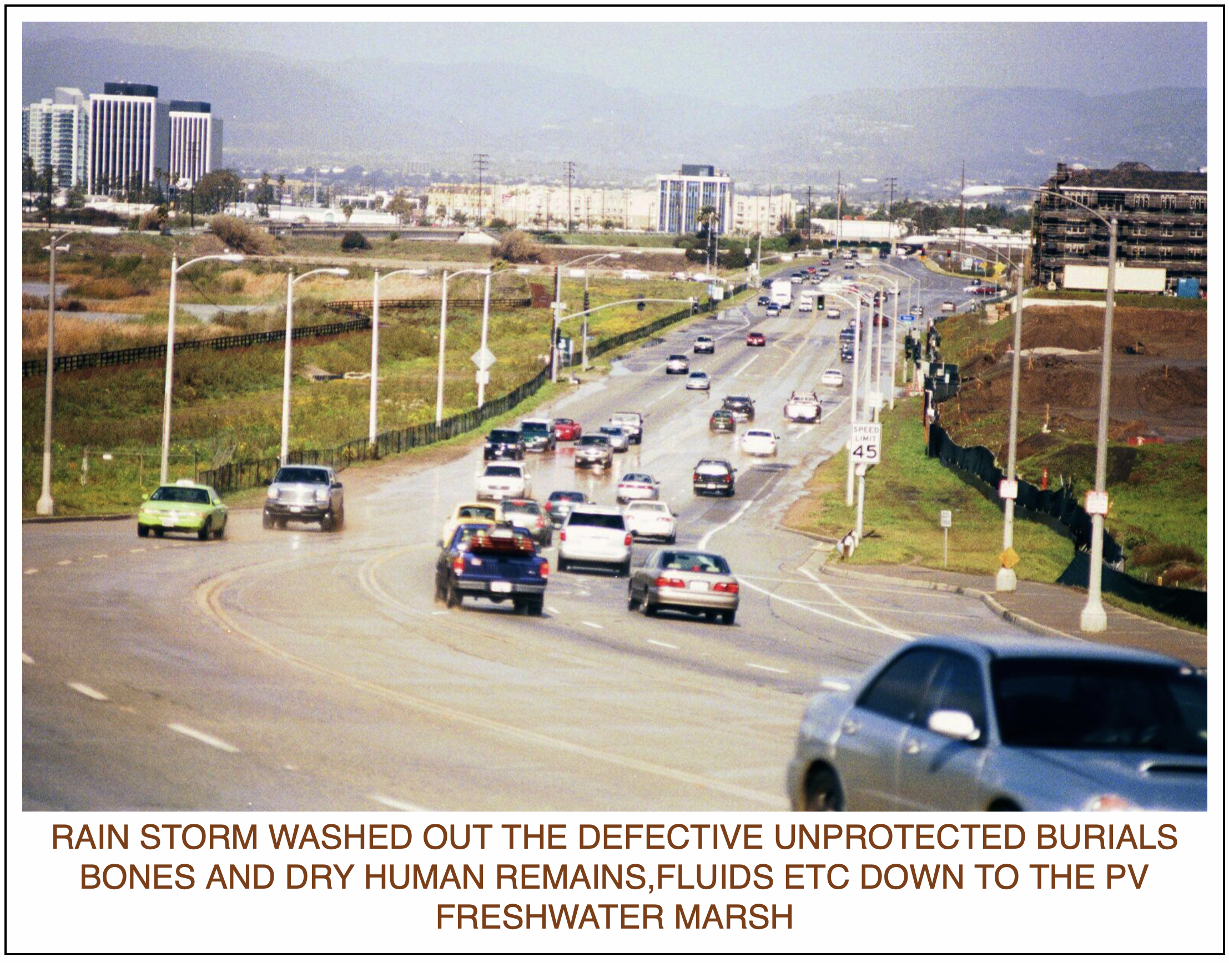

Slide 12
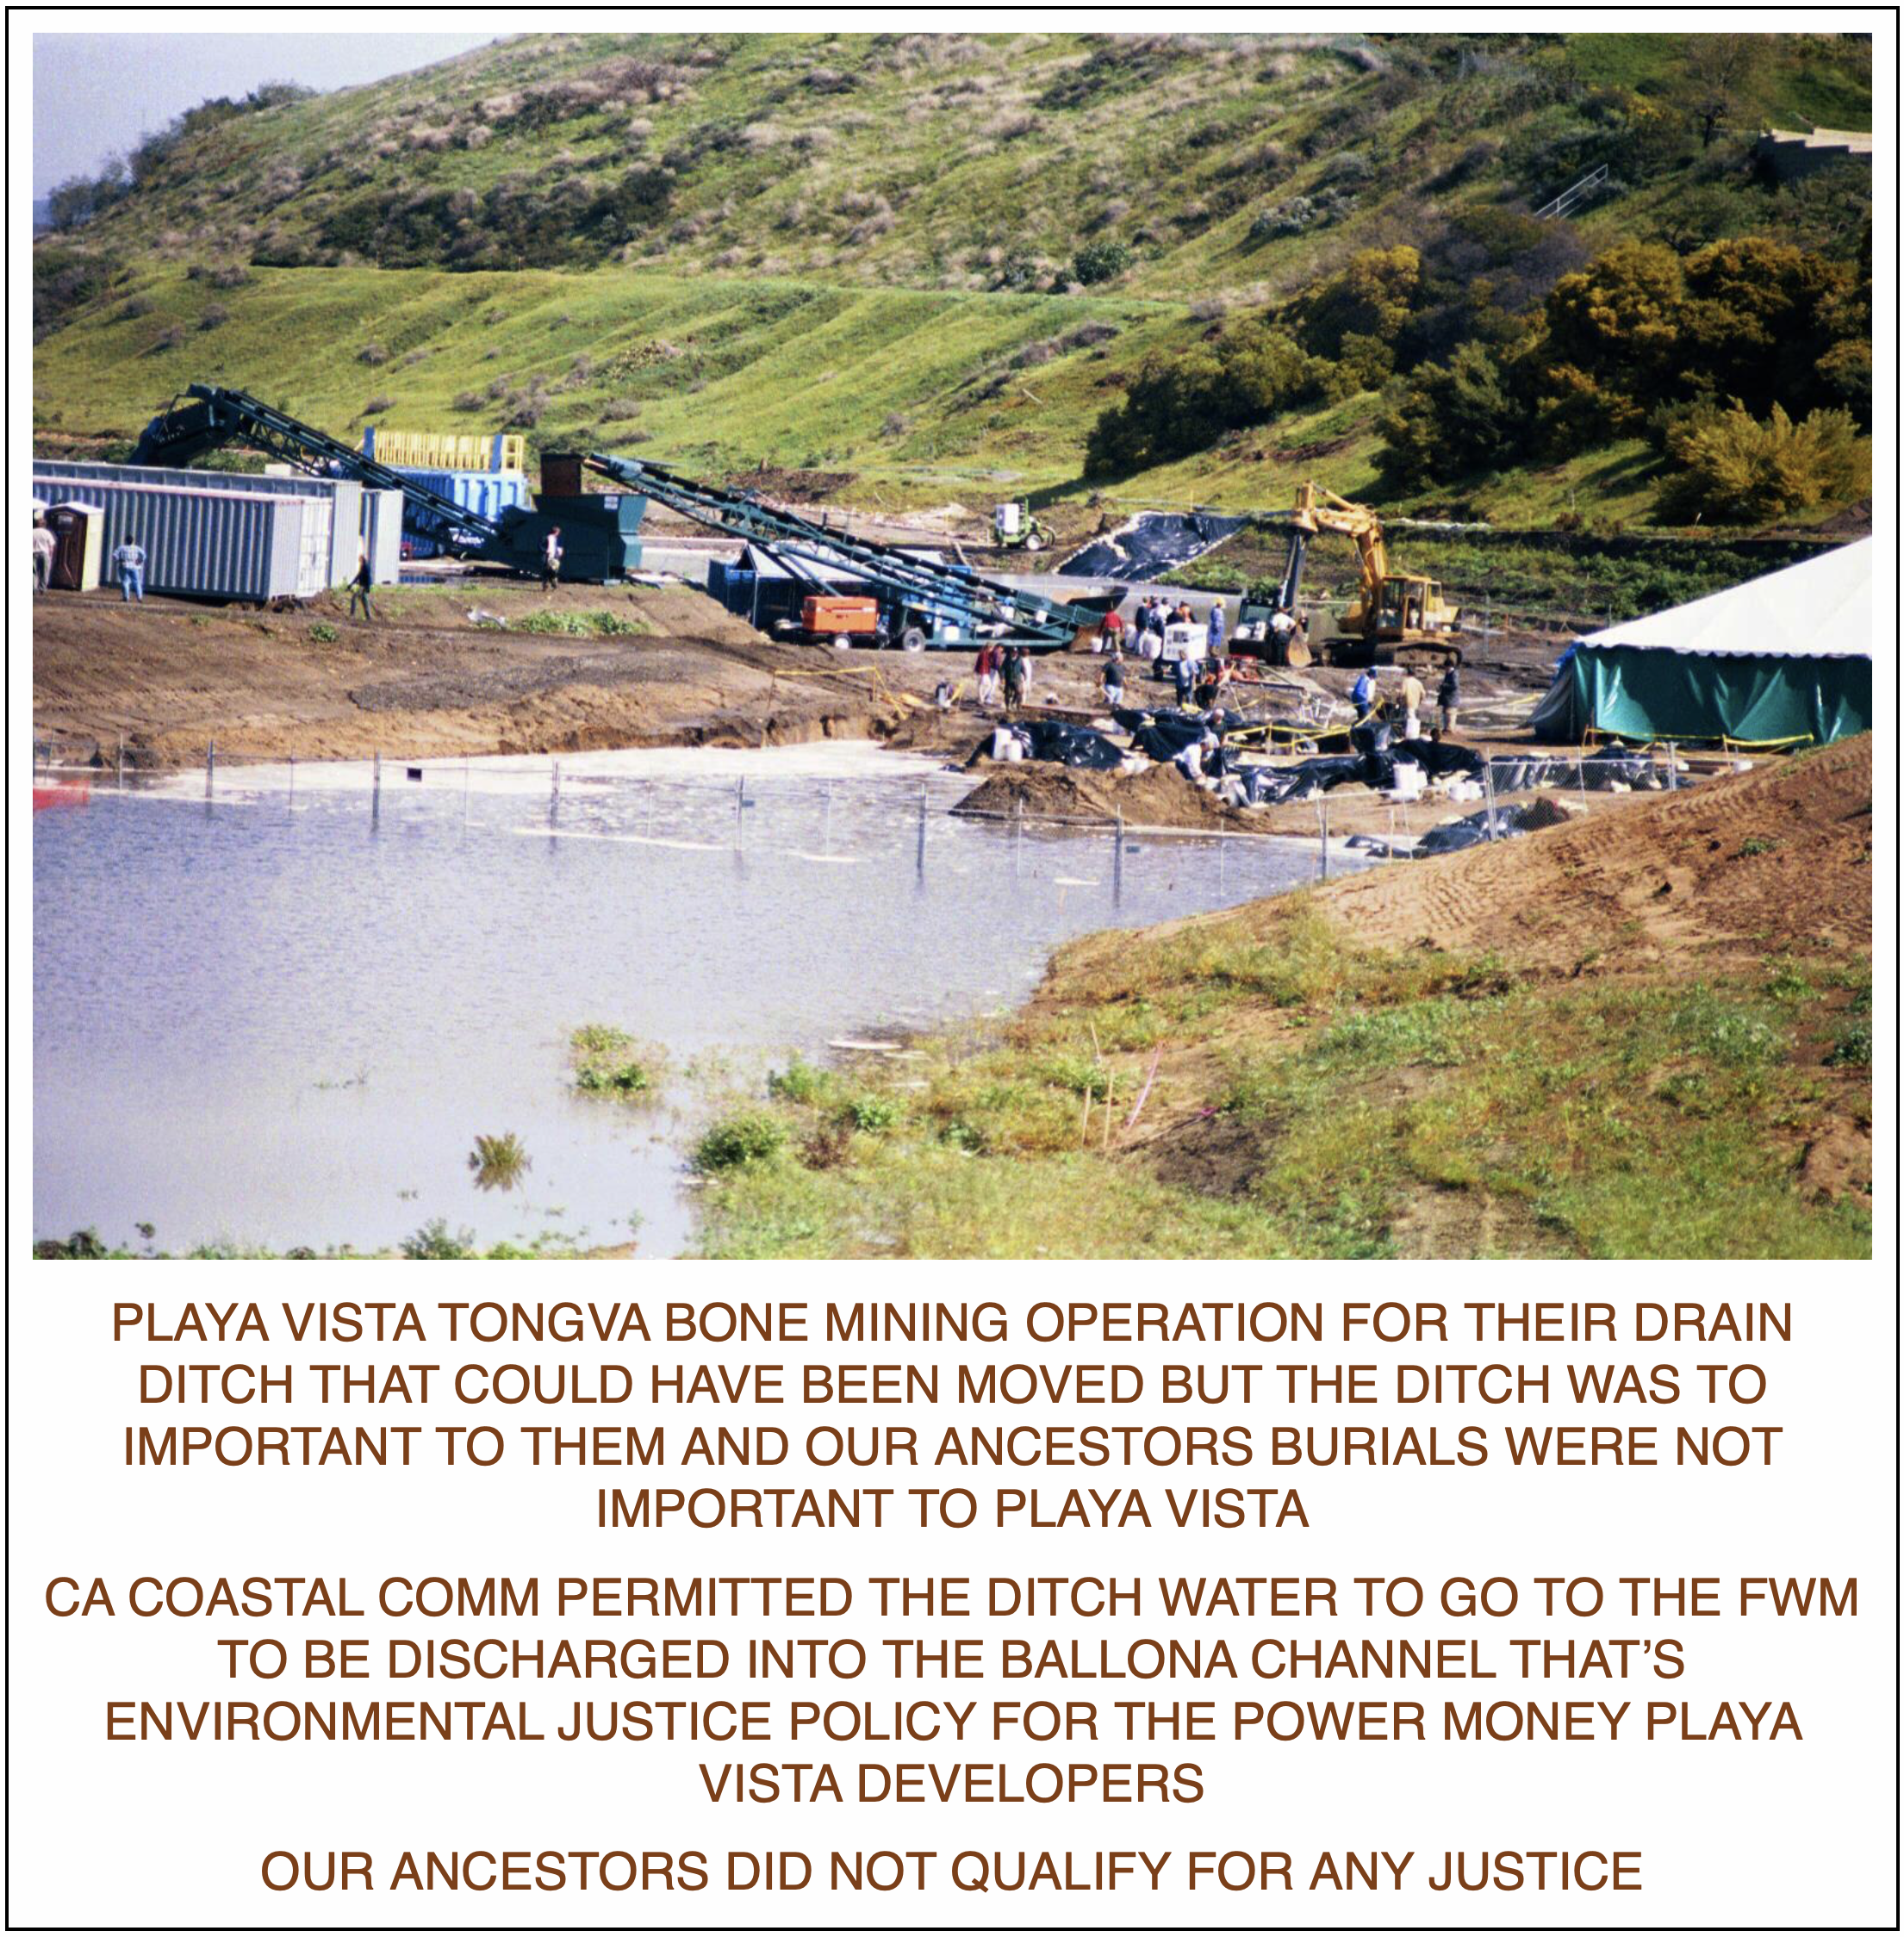

Slide 13
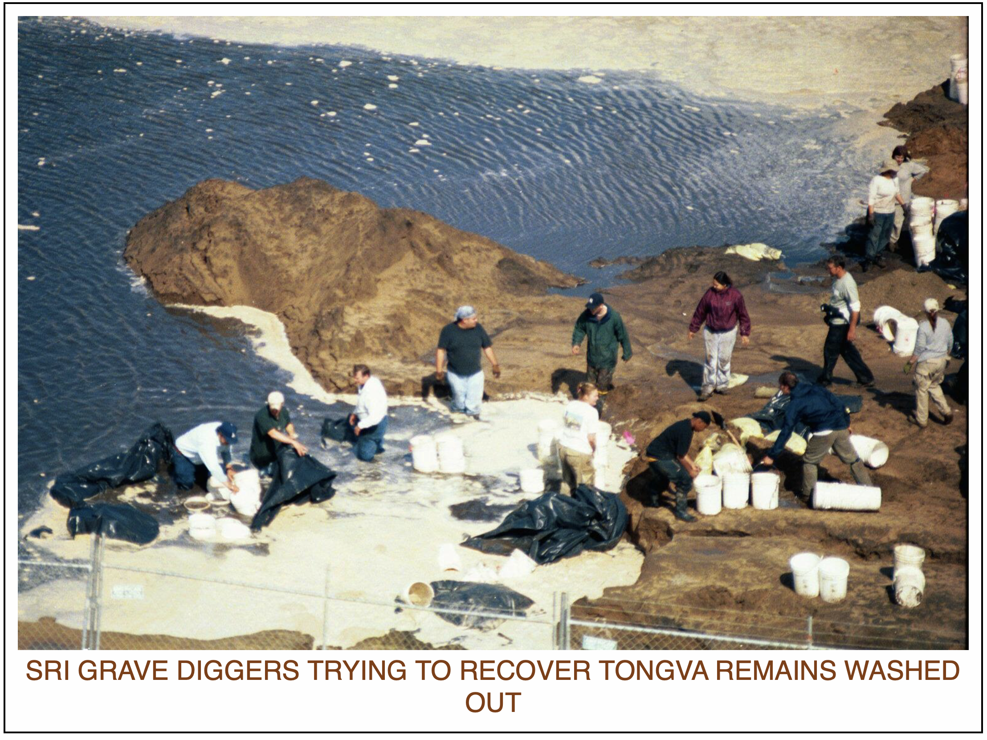

Slide 14
